Slide 1
Chapter 9
ER-to-Relational Mapping and
The Relational Calculus –A Formal Query Language
ER-to-Relational Mapping
Introduction to Relational Calculus
Tuple Relational Calculus
  Tuple Variables and Range Relations
  Formal Specification of Tuple Relational Calculus
  Queries Using the Existential Quantifier
  Transforming Universal and Existential Quantifiers
  Universal Quantifiers and Safe Expressions
Domain Relational Calculus

Slide 2
1.ER-to-Relational Mapping
We use the Company database as an example.
Step 1: Regular (strong) entity type E in ER schema
  Create a relation R that includes all the simple attributes of E.
  Include only the simple component attributes of a composite attribute.
  Choose one of the key attributes of E as primary key for R.

Slide 3
Step 2: Weak entity type W (with owner entity type E)
  create a relation R
  include all simple attributes (simple components, if composite attributes) of W as attributes of R
  include in R the primary key attribute(s) K of the relation(s) that correspond to the owner entity type(s)
  assign the combination of the partial key K’ of W and K as the primary key of R (primary key = K + K’)

Slide 4
Step 3: Binary 1:1 relationship type R (of relations S and T) in the ER schema
  Choose one of the relations, say S, and include the primary Key of T as foreign key in S (it’s better to choose the one with total participation in the relationship, for performance (join) reasons)
  Include all the simple attributes (or simple components of composite attributes) of the 1:1 relationship type R as attributes of S
  (When both participations of S and T are total and R is 1:1, we can even merge S and R and T as one relation.)

Slide 5
Step 4: Binary 1:N relationship type R (with S being the N side)
  include as foreign key in S the primary key of the relation T
  include simple attributes (or simple components of composite attributes) of the relationship type R as attributes of S.

Slide 6
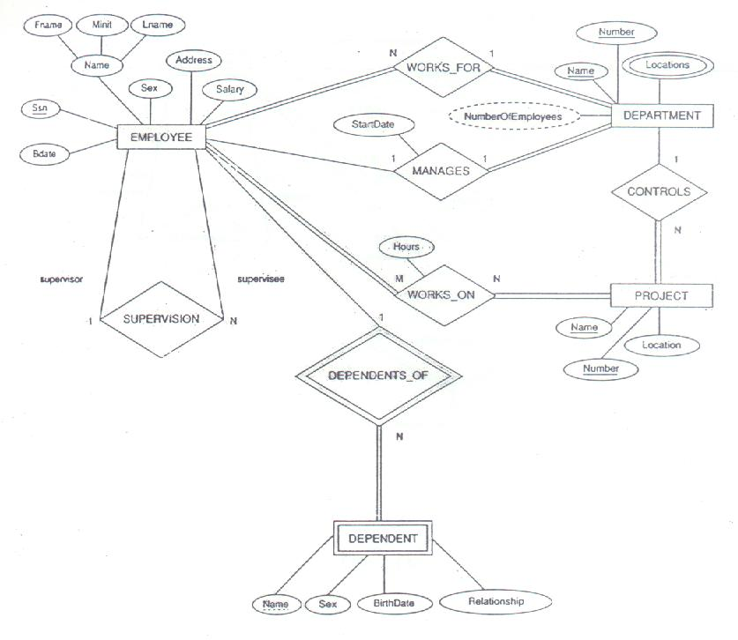

Slide 7
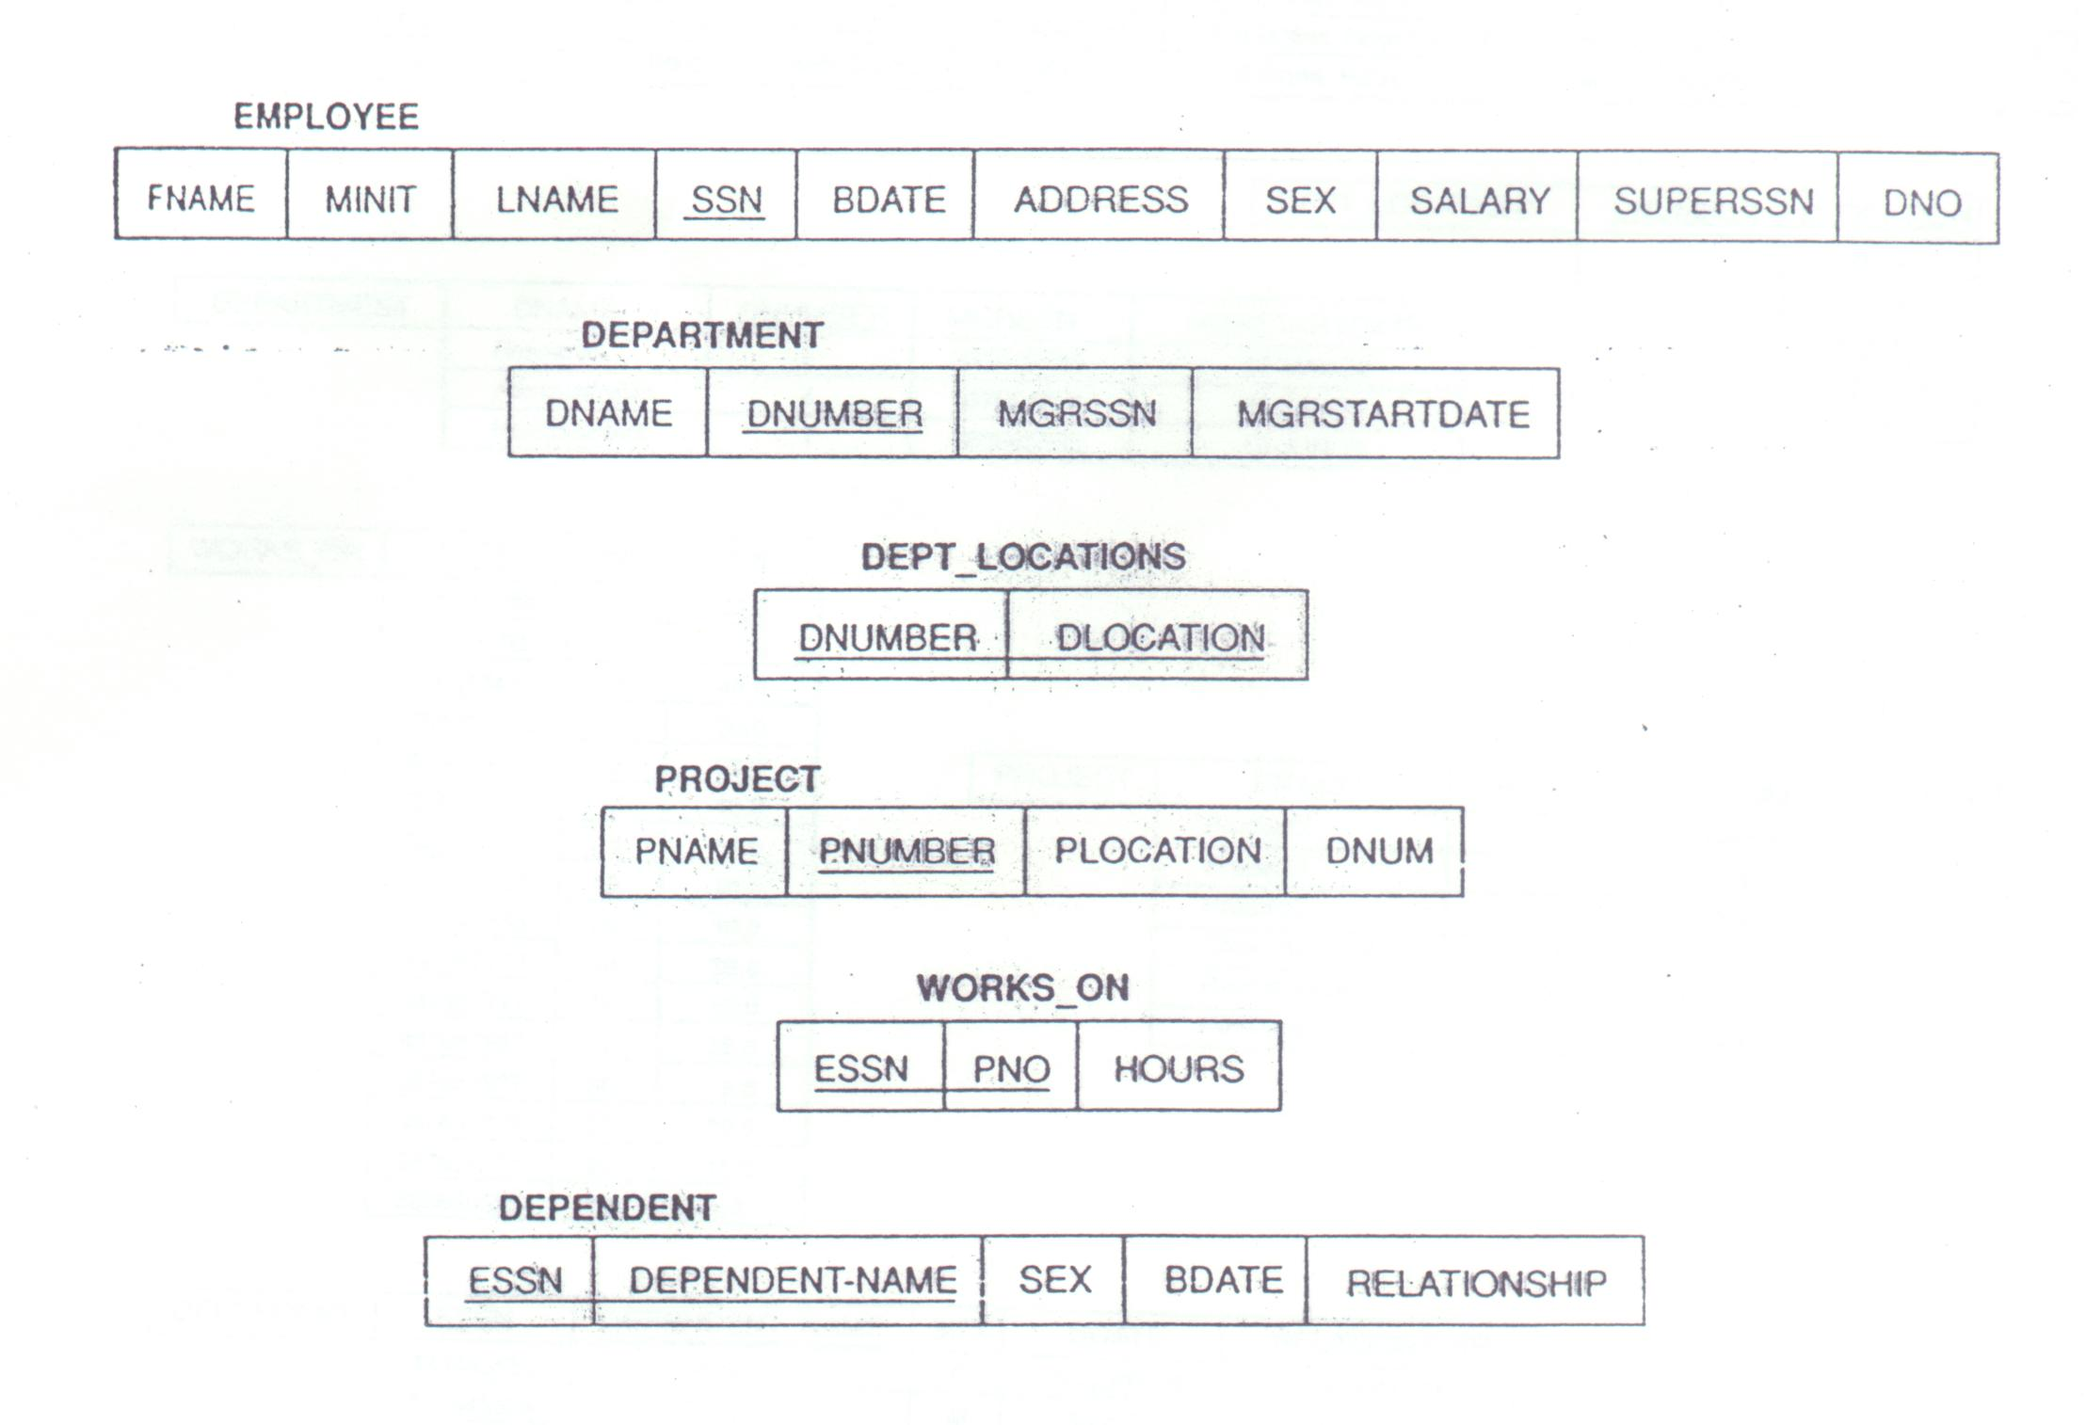

Slide 8
Step 5: Binary M:N relationship type R (of relations S and T)
  create a new relation R’ to represent the relationship type R
  include as foreign key attributes in R’ the primary keys of the relations S and T; their combination forms the primary key of R’
  include simple attributes of the M:N relationship type R as attributes of R’.

Slide 9
Step 6: Multivalued attribute A of an entity type E
  create a new relation R
  R include A as well as K (the primary key of E); the combination of A and K is the key of R
  if the mutivalued attribute is composite, then A means the set of its simple attributes

Slide 10
Step 7: N-ary relationship type R
  create R’ to represent R
  include as attributes of R’ all the primary keys of the relations that represent the participating entity types
  the primary key of R’ is normally the combination of all those key attributes from the relationship-participating relations; (HOWEVER, if the cardinality ratio on any of the participating entity types E is 1, then the combination should not include E’s key attribute.) – 因為1:m:n時，由m和n來的key的combination就已經可以uniquely identify a tuple。故只需include 1 side 的key, as an attribute, but does not need to make it as a part of the composite key.

Slide 11
2. Introduction to Relational Calculus
A formal language based on first-order predicate calculus
Many commercial relational languages based on some aspects of relational calculus, including SQL
QUEL, QBE (Chapter 9) closer to relational calculus than SQL
Different from relational algebra:
  One declarative calculus expression specifies a retrieval query

Slide 12
(cont.)
  A sequence of operations is used in relational algebra
  Relational algebra more procedural
  Relational calculus more declarative (less procedural)
  Expressive power of the two languages is identical
Relational completeness:
  A relational query language L is relationally complete if we can express in L any query that can be expressed in the relational calculus(or algebra)
  Most relational query languages are relationally complete
  More expressive power is provided by operations such as aggregate functions, grouping, and ordering

Slide 13
3. Tuple Relational Calculus
3.1 Tuple Variables and Range Relations
  A tuple variable ranges over the tuples of a particular relation
  Example: Find all employees whose salary is above $50000:
  {t | EMPLOYEE(t) and t.SALARY>50000}
  EMPLOYEE(t) specifies the range relation EMPLOYEE for the tuple variable t
  Each tuple t satisfying t.SALARY>50000 is retrieved
  Retrieves the whole tuple t
  To retrieve only some attributes of t:
  {t.FNAME, t.LNAME | EMPLOYEE(t) and t.SALARY>50000}

Slide 14
(cont.)
  Similar to the SQL query:
  SELECT T.FNAME, T.LNAME
  FROM EMPLOYEE T
  WHERE T.SALARY > 50000

Slide 15
3.2 Formal Specification of Tuple Relational Calculus
Form of relational calculus expression:
{t₁.A₁, t₂.A₂, …, t_{n}.A_{n} | COND (t₁, t₂, … , t_{n}, t_{n+1}, t_{n+2}, … t_{n+m} )}
t₁, t₂, … , t_{n}, t_{n+1}, t_{n+2}, … t_{n+m} are tuple variables
Each A_{i} is an attribute of the relation on which t_{i} ranges
COND is a condition, or formula of the tuple relational calculus

Slide 16
(cont.)
Formula made up of atoms of the following types:
R(t_{i}) identifies R as range of t_{i}
(t_{i}.A op t_{j}.B), where op is a comparison operator( =, <, <=, …)
(t_{i}.A op c) or (c op t_{j}.B), where c is a constant value
An atom evaluates to either TRUE or FALSE for a specific combination of tuples
Called the truth value of an atom
Formula: Atoms connected via and , or, and not
Every atom is a formula; if F₁ and F₂ are formulas, so are:(F₁ and F₂), (F₁ or F₂), not (F₁), and not(F₂)

Slide 17
(cont.)
Quantifiers:
  Universal quantifier(∀) (reads for all)
  Existential quantifier(∃) (reads their exists)
Free and bound tuple variables:
  Occurrence of t in a formula F that is an atom is free in F
  Occurrence of t is free in (F₁ and F₂), (F₁ or F₂), not (F₁), and not(F₂) depending on whether or not it is free in F₁ or F₂
  All free occurrences of t in F are bound to the quantifier in a formula F’ = ( ∃t)(F) or F’ = (∀t)(F)

Slide 18
(cont.)
  Examples:
  F1:d.DNAME = ‘Research’
  F2:(∃t)(d.DBUMBER = t.DNO)
  d is free in both F1 and F2
  t is bound to the ∃ quantifier in F2
Quantifiers in formulas:
  If F is a formula,then so is (∃t)(F)
  (∃t)(F) is TRUE if F evaluates to TRUE for at least one tuple assigned to free occurrences of t in F; otherwise it is FALSE

Slide 19
(cont.)
  If F is a formula, then so is (∀t)(F)
  (∀t)(F) is TRUE if F evaluates to TRUE for every tuple (in the universe) assigned to free occurrences of t in F; otherwise it is FALSE
  ∃ called existential quantifier because (∃t)(F) is TRUE if “there exists” some tuple t that makes F TRUE
  ∀ called universal quantifier because every tuple in “the universe of“ tuples must make F TRUE if (∀t)(F) is to be TRUE

Slide 20
3.3 Queries Using the Existential Quantifier
Query 1: Retrieve the name and address of all employees who work for the ‘Research’ department.
  Q1:{t.FNAME, t.LNAME, t.ADDRESS | EMPLOYEE(t) and (∃d)(DEPARTMENT(d) and d.DNAME = ‘Research’ and d.DNUMBER = t.DNO)}
The only free tuple variables in a relational calculus expression should be those that appear to the left of the bar(|)
Each free variable is bound successively to each tuple that satisfies the condition to the right of the bar(|)

Slide 21
(cont.)
The bar(|) reads as “such that”
EMPLOYEE(t), DEPARTMENT(d) specify range relations for t,d
The condition d.NAME = ‘Research’ is a selection condition (corresponds to SELECT in relational algebra)
The condition d.DNUMBER = t.DNO is a join condition (serves a similar purpose to EQUIJOIN in relational algebra)

Slide 22
(cont.)
Query 2: For every project located in ‘Stafford’, retrieve the project number; the controlling department number; and the last name, birthdate, and address of the manager of that department
  Q2:{p.PNUMBER, p.DNUM, m.LNAME, m.BDATE, m.ADDRESS | PROJECT(p) and EMPLOYEE(m) and p.PLOCATION = ‘Stafford’ and ((∃d)(DEPARTMENT(d) and p.DNUM = d.DNUMBER and d.MGRSSN = m.SSN))}
Query 8: For each employee, retrieve the employee’s first and last name, and the first and last name of his/her immediate supervisor
  Q8:{e.FNAME, e.LNAME, s.FNAME, s.LNAME|EMPLOYEE(e) and EMPLOYEE(s) and e.SUPERSSN = s.SSN}

Slide 23
(cont.)
Query 3’: Find the name of each employee who works on some project controlled by department number 5.
  Q3’:{e.LNAME, e.FNAME|EMPLOYEE(e) and ((∃x)(∃w)(PROJECT(x) and WORKS_ON(w) and x.DNUM = 5 and w.ESSN = e.SSN and x.PNUMBER = w.PNO))}
Query 4: Make a list of all projects that involve a person whose last name is ‘Smith’ as a worker or as manager of the controlling department.
  Q4:{p.PNAME|PROJECT(p) and (((∃e)(∃w)(EMPLOYEE(e) and WORKS_ON(w) and e.LNAME = ‘Smith’ and e.SSN = w.ESSM))

Slide 24
(cont.)
  or
  ((∃m)(∃d)(EMPLOYEE(m) and DEPARTMENT(d) and p.DNUM = d.DNUMBER and d.MGRSSN = m.SSN and m.LNAME = ‘Smith’)))}
In general, UNION in relational algebra corresponds to an or connective in relational calculus
INTERSECTION corresponds to an and connective
The not connective can be used to transform universal and existential quantifiers to equivalent formulas

Slide 25
3.4 Transforming Universal and Existential Quantifiers
Well-known transformations from mathematical logic
  (∀x)(P(x)) ≡ (not ∃x)(not (P(x)))
  (∃x)(P(x)) ≡ not (∀x)(not(P(x)))
  (∀x)(P(x) and Q(x)) ≡ (not ∃x)(not(P(x)) or not (Q(x)))
  (∀x)(P(x) or Q(x)) ≡ (not ∃x)(not(P(x)) and not (Q(x)))
  (∃x)(P(x) or Q(x)) ≡ not(∀x)(not(P(x)) and not (Q(x)))
  (∃x)(P(x) and Q(x)) ≡ not(∀x)(not(P(x)) or not (Q(x)))
The following is also true, where ⇒ stands for implies:
  (∀x)(P(x)) ⇒ (∃x)(P(x))
  (not ∃x)(P(x)) ⇒ not (∀x)(P(x))

Slide 26
(cont.)
The following is not true:
  not(∀x)(P(x)) ⇒ (not ∃x)(P(x))

Slide 27
3.5 Universal Quantifiers and Safe Expressions
One must be careful when specifying universal quantification
Judicious to follow rules to ensure expression makes sense
Otherwise,unsafe expressions may result
Query 3: Find the names of employees who works on all projects controlled by department number 5.
  Q3:{e.LNAME, e.FNAME|EMPLOYEE(e) and ((∀x)(not(PROJECT(x)) or (not(x.DNUM = 5) or ((∃w)(WORKS_ON(w) and w.ESSN = e.SSN and x.PNUMBER = w.PNO)))))}

Slide 28
(cont.)
We discuss rules for safe expressions using the universal quantifier by looking at query Q3
Basic components of Q3:
  Q3:{e.LNAME, e.FNAME|EMPLOYEE(e) and F’}
  F’ = (∀x)(not(PROJECT(x)) or F₁)
  F₁ = (not(x.DNUM = 5) or F₂)
  F₂ = (∃w)(WORKS_ON(w) and w.ESSN = e.SSN and x.PNUMBER = w.PNO)
Must exclude all tuples not of interest from the universal quantification by making the condition TRUE for all such tuples

Slide 29
(cont.)
Universally quantified variable x must evaluate to TRUE for every possible tuple in the universe
In F’, not(PROJECT(x)) makes x TRUE for all tuples not in the relation of interest “PROJECT”
In F₁, not(x.DNUM = 5) makes x TRUE for those PROJECT tuples we are not interested in “whose DNUM is not 5”
F₂ specifies the condition that must hold on all remaining tuples “all PROJECT tuples controlled by department 5”

Slide 30
(cont.)
Safe expressions in the relational calculus:
  Is guaranteed to yield a finite number of tuples as its result
  Unsafe expression may yield infinate number of tuples, and the tuples may be of different types.
  Example:
  {t|not(EMPLOYEE(t))}
  Yields all non-EMPLOYEE tuples in the universe
  Following the rules for Q3 discussed above guarantees safe expressions when using universal quantifiers

Slide 31
(cont.)
  Using transformations from universal to existential quantifiers, can rephrase Q3 as Q3’:
  Q3’:{e.KNAME, e.FNAME|EMPLOYEE(e) and (not(∃x)(PROJECT(x) and (x.DNUM = 5) and (not(∃w)(WORKS_ON(w) and w.ESSN = e.SSN and x.PNUMBER = w.PNO))))}
Additional examples:
  Query 6: Find the names of employees without any dependents
  Q6:{e.FNAME, e.LNAME|EMPLOYEE(e) and (not(∃d)(DEPARTMENT(d) and e.SSN = d.ESSN))}

Slide 32
(cont.)
  Transforming Q6 into Q6’ to use universal quantifier
  Q6’:{e.FNAME, e.LNAME|EMPLOYEE(e) and ((∀d)(not(DEPENDENT(d)) or not (e.SSN = d.ESSN)))}
  Query 7: List the names of managers who have at least one dependent
  Q7:{e.FNAME, e.LNAME|EMPLOYEE(e) and ((∃d)(∃P)(DEPARTMENT(d) and DEPENDENT(p) and e.SSN = d.MGRSSN and p.ESSN = e.SSN))}

Slide 33
5. Domain Relational Calculus
Uses domain variables rather than tuple variables
Each variable ranges over the domain of an attribute
To form a relation of degree n, must specify n domain variables
Example:
  Query 0: Retrieve the birthdate and address of the employee whose name is ‘John B. Smith’
  Q0:{uv|(∃q)(∃r)(∃s)(EMPLOYEE(qrstuvwxyz) and q = ‘John’ and r = ‘B’ and s = ‘Smith’)}

Slide 34
(cont.)
  Ten domain variables for EMPLOYEE; one for each attribute
  Variable u for BDATE, v for ADDRESS
  Condition involves variables q (FNAME), r(MINIT), and s(LNAME)
  Existentially quantify only those variables participating in a condition; these are q, r, and s
Alternative notation (used in QBE):
  Q0’:{uv|EMPLOYEE(‘John’, ‘B’, ‘Smith’, t,u,v,w,x,y,z)}

Slide 35
(cont.)
  Query 1: Retrieve the name and address of all employees who work for the ‘Research’ department
  Q1:{qsv|(∃z)(EMPLOYEE(qrstuvwxyz) and
  (∃l)(∃m)(DEPARTMENT(lmno) and l =
  ‘Research’ and m = z))}
  (m=z) is a join condition
  (l = ‘Research’) is a selection condition
  Query 2: For every project located in ‘Stafford’, list the project number, the controlling department number; and the last name, birthdate, and address of the manager of that department.

Slide 36
(cont.)
  Q2:{iksuv|(∃j)(PROJECT(hijk) and
  (∃t)(EMPLOYEE(qrstuvwxyz) and
  (∃m)(∃n)(DEPARTMENT(lmno) and k = m
  and n = t and j = ‘Stafford’)))}
  Query 6: Find the names of employees without dependents
  Q6:{qs|(∃t)(EMPLOYEE(qrstuvwxyz) and
  (not(∃l)(DEPENDENT(lmno) and t = l)))}
  Query 7: List the names of managers who have at least one dependent

Slide 37
(cont.)
Q7:{sq|(∃t)(EMPLOYEE(qrstuvwxyz) and ((∃j)(DEPARTMENT(hijk) and ((∃l)(DEPARTMENT(lmno) and t = j and l = t)))))}

